Slide 1








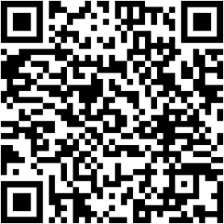





Do you receive [INSERT PROGRAM NAME]
benefits?
INSERT LOGO HERE
A copy of notice of [PROGRAM NAME] approval
Other documentation of eligibility or benefits from the [PROGRAM NAME] agency, such as a screenshot from a [PROGRAM NAME] mobile app
Your household’s [PROGRAM NAME] card
(Electronic Benefit Transfer [EBT] card)

